Slide 1
Natural Language Processing DSECL ZG565
Prof.Vijayalakshmi Anand
BITS-Pilani

Slide 2
Session 4-Part-of-Speech Tagging (Viterbi ,Maximum entropy)
Date – 20th Sep 2020
Time – 9 am to 11am
These slides are prepared by the instructor, with grateful acknowledgement of James Allen and many others who made their course materials freely available online.

Slide 3

What is POS tagging
Application of POS tagging
Tag sets –standard tag set
Approaches of POS tagging
Introduction to HMM
How HMM is used in POS tagging

Slide 4
Session4-POS tagging(Viterbi ,Maximum entropy model)
The Hidden Markov Model
Likelihood Computation:
The Forward Algorithm
Decoding: The Viterbi Algorithm
Bidirectionalty
Maximum entropy model

Slide 5
Hidden Markov Models
It is a sequence model.
Assigns a label or class to each unit in a sequence, thus mapping a sequence of observations to a sequence of labels.
Probabilistic sequence model: given a sequence of units (e.g. words, letters, morphemes, sentences), compute a probability distribution over possible sequences of labels and choose the best label sequence.
This is a kind of generative model.

Slide 6
Hidden Markov Model (HMM)
Oftentimes we want to know what produced the sequence – the hidden sequence for the observed sequence. For example,
Inferring the words (hidden) from acoustic signal (observed) in speech recognition
Assigning part-of-speech tags (hidden) to a sentence (sequence of words) – POS tagging.
Assigning named entity categories (hidden) to a sentence (sequence of words) – Named Entity Recognition.

Slide 7
Definition of HMM
States Q = q₁, q₂…q_{N;}
Observations O= o₁, o₂…o_{N;}
Each observation is a symbol from a vocabulary V = {v₁,v₂,…v_{V}}
Transition probabilities
Transition probability matrix A = {a_{ij}}
Observation likelihoods
Output probability matrix B={b_{i}(k)}
Special initial probability vector π

Slide 8
Three Problems
Given this framework there are 3 problems that we can pose to an HMM
Given an observation sequence, what is the probability of that sequence given a model?
Given an observation sequence and a model, what is the most likely state sequence?
Given an observation sequence, find the best model parameters for a partially specified model

Slide 9
Problem 1: Observation Likelihood
The probability of a observation sequence given a model and state sequence
Evaluation problem

Slide 10
Problem 2:
Most probable state sequence given a model and an observation sequence
Decoding problem

Slide 11
Problem 3:
Infer the best model parameters, given a partial model and an observation sequence...
That is, fill in the A and B tables with the right numbers --
the numbers that make the observation sequence most likely
This is to learn the probabilities!

Slide 12
Solutions
Problem 1: Forward (learn observation sequence)
Problem 2: Viterbi (learn state sequence)
Problem 3: Forward-Backward (learn probabilities)
An instance of EM (Expectation Maximization)

Slide 13
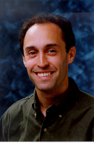
Example :HMMs for Ice Cream
You are a climatologist in the year 2799 studying global warming
You can’t find any records of the weather in Baltimore for summer of 2007
But you find Jason Eisner’s diary which lists how many ice-creams Jason ate every day that summer
Your job: figure out how hot it was each day

Slide 14
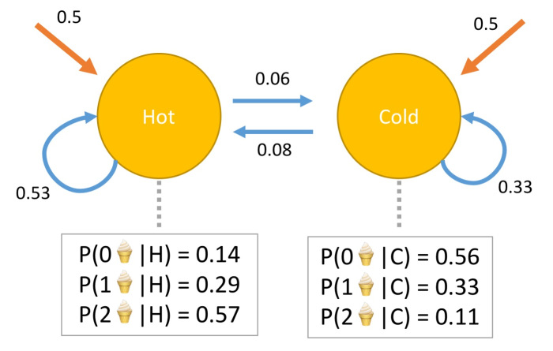
Problem 1
1.Consider all possible 3-day weather sequences [H, H, H], [H, H, C], [H, C, H],
2. For each 3-day weather sequence, consider the probability of the ice cream Consumption sequences [1,2,1]
3.Add all the probability
Not efficient
Forward algorithm

Slide 15
Problem2
.
1.Consider all possible 3-day weather sequences [H, H, H], [H, H, C], [H, C, H],
2. For each 3-day weather sequence, consider the probability of the ice cream Consumption sequences [1,2,1]
3. Pick out the sequence that has the highest probability from step #2.
Not efficient
Viterbi algorithm

Slide 16
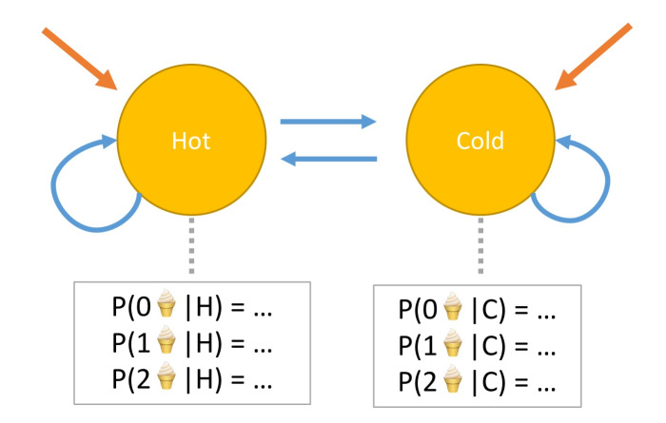
Problem3
Find :
The start probabilities
The transition probabilities
Emission probabilities
Forward –backward algorithm

Slide 17

Problem 2: Decoding
We want, out of all sequences of n tags t₁…t_{n} the single tag sequence such that
P(t₁…t_{n}|w₁…w_{n}) is highest.
Hat ^ means “our estimate of the best one”
Argmax_{x} f(x) means “the x such that f(x) is maximized”

Slide 18
Getting to HMMs
This equation should give us the best tag sequence
But how to make it operational? How to compute this value?
Intuition of Bayesian inference:
Use Bayes rule to transform this equation into a set of probabilities that are easier to compute (and give the right answer)

Slide 19
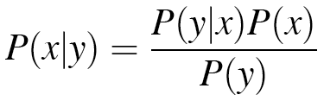
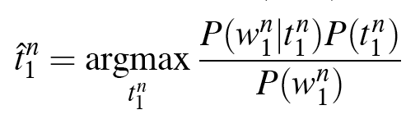
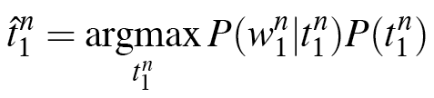
Using Bayes Rule
Know this.

Slide 20
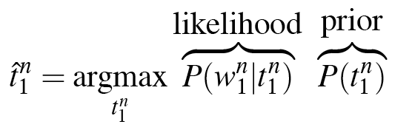
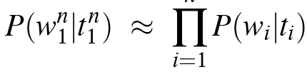
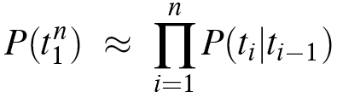
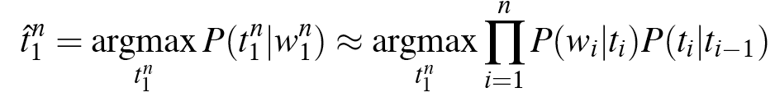
Likelihood and Prior

Slide 21
HMM for Ice Cream
Given
Ice Cream Observation Sequence: 1,2,3,2,2,2,3…
Produce:
Hidden Weather Sequence:
H,C,H,H,H,C, C…

Slide 22
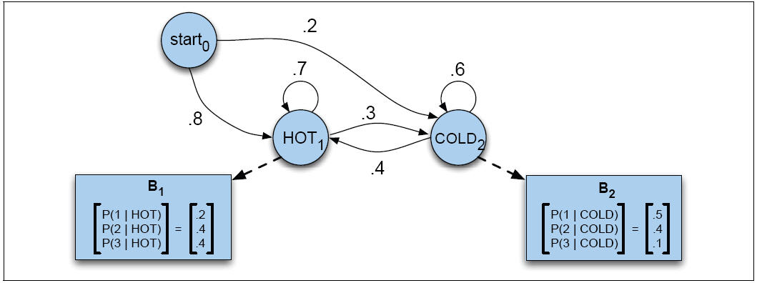
HMM for Ice Cream
the observed sequence “1 2 3”

Slide 23
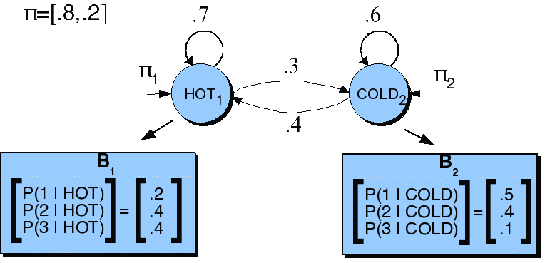
HMM for Ice Cream
Transition probability
Emission probabilities
 | H | C
H | 0.7 | 0.3
C | 0.4 | 0.6
 | 1 | 2 | 3
H | 0.2 | 0.4 | 0.4
C | 0.5 | 0.4 | 0.1

Slide 24
Find 131 sequence
P(a,b)=P(a|b) P(b)
P(131|HCH)=P(1|H)P(3|C)P(1|H) P(S|H)P(C|H)P(H|C)
1 2 ------8(N^T=2^3)
H
c
H
H
H
c
3
1
3
3
1
3

Slide 25
Decoding
• Given an observation sequence
3 1 3
• And an HMM
• The task of the decoder
To find the best hidden state sequence most likely to have produced the observed sequence
• Given the observation sequence O=(o1o2…oT), and an HMM model Φ = (A,B), how do we choose a corresponding state sequence Q=(q1q2…qT) that is optimal in some sense (i.e., best explains the observations)

Slide 26

Contd..
• One possibility to find the best sequence is :
For each hidden state sequence Q
HHH, HHC, HCH,
Compute P(O|Q)
Pick the highest one
• Why not?
• Instead:
- The Viterbi algorithm
- Is a dynamic programming algorithm

Slide 27


Viterbi intuition
We want to compute the joint probability of the observation sequence together with the best state sequence

Slide 28
P(1,H)=P(1/H)*P(H/H)
=0.2*0.7
=0.14
P(3,H)=P(3/H)*P(H/H)
= 0.4*0.7
=0.28
P(1,H)=P(1/H)*P(C/H)
=0.2*0.4
=0.08
P(3,H)=P(3/H)*P(H/C)
= 0.1*0.2
=0.02
V2=Max [(0.14*0.32=0.0448),(0.08*0.02=0.0016)]
P(3,H)=P(3/H)*P(H)
= 0.4*0.8
=0.32
V3=Max[(0.28*0.0448=0.013),(0.02*0.048=0.00096)
V1=0.32
V2=0.0448
V3=0.013
H
0.14
H
0.28
H
0.08
0.15
0.04
0.02
S
C
C
C
0.3
V2=0.048
0.06
V3=Max[(0.048*0.06=.00288),(0.0448*0.04=0.001792)
0.02
V3=.00288
P(3,C)=P(3/C)*P(C)
= 0.1*0.2
=0.02
3
1
3
P(1,C)=P(1/C)*P(C/H)
=0.5*0.3
=0.15
V2 =Max[(0.15*0.32=0.048),(0.02*0.3=0.006)]
P(3,C)=P(3/C)*P(C/C)
= 0.1*0.6
=0.06
P(1,C)=P(1/C)*P(C/C)
=0.5*0.6
=0.30
P(3,C)=P(3/C)*P(C/H)
= 0.1*0.4
=0.04

Slide 29
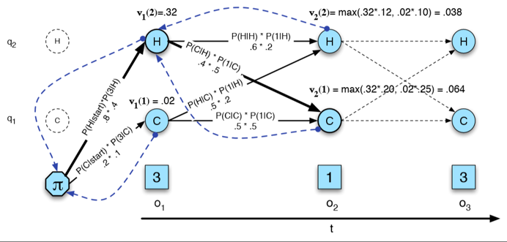

Slide 30
Example: Rainy and Sunny Days
Your colleague in another city either walks to work or drives every day and his decision is usually based on the weather
Given daily emails that include whether he has walked or driven to work, you want to guess the most likely sequence of whether the days were rainy or sunny
Two hidden states: rainy and sunny
Two observables: walking and driving
Assume equal likelihood of the first day being rainy or sunny
Transitional probabilities
rainy given yesterday was (rainy = .7, sunny = .3)
sunny given yesterday was (rainy = .4, sunny = .6)
Output (emission) probabilities
sunny given walking = .1, driving = .9
rainy given walking = .8, driving = .2
Given that your colleague walked, drove, walked, what is the most likely sequence of days?

Slide 31
State1:Walk
P(rainy| walk)=P(walk, rainy)*P(rainy) V1=0.40
=0.8*0.5=0.40
P(walk| sunny)=P(walk, sunny)*P(sunny) V1=0.05
=0.1*0.5=0.05
State2: Drive
P(rainy|drive)=P(drive, rainy)*P(rainy, rainy) V2=max(0.40*0.14=0.056,
=0.2*0.7=0.14 0.05*0.06=0.003)
=P(drive,rainy)*P(rainy|sunny) =0.56
=0.2*0.3=0.06
P(sunny|drive)=P(drive,sunny)*P(sunny|sunny) V2 =max(0.36*0.40=0.144,
= 0.9*0.6=0.54 0.05*0.5=0.0027)
=P(drive,sunny)*P(sunny|rainy) =0144
=0.9*0.4=0.36

Slide 32
State 3:Walk
P(rainy|walk)=P(rainy,walk)*P(rainy|rainy) v3=max(0.56*0.056=0.3136,
=0.8*0.7=0.56 (0.0144*0.04=0.00051)
=P(rainy,walk)*P(rainy|sunny) =0.3136
=0.8*0.3=0.24
P(sunny|walk)=P(sunny,walk)*P(sunny|sunny) V3=max(0.056*0.24=0.0134,
=0.1*0.6=0.06 0.144*0.06=0.008)
=P(sunny,walk)*P(sunny|raniy) =0.0134
=0.1*0.4=0.04

Slide 33
v1=0.40
0.8*0.5=0.40
0.1*0.5=0.05
v1=0.54
V2=0.056
V3=0.3136
rainy
0.14
rainy
0.56
rainy
0.04
0.06
0.24
0.36
start
sunny
sunny
sunny
0.06
0.54
V2=0.144
V3=0.0134
Walk
drive
walk
The best sequence =sunny rainy rainy

Slide 34
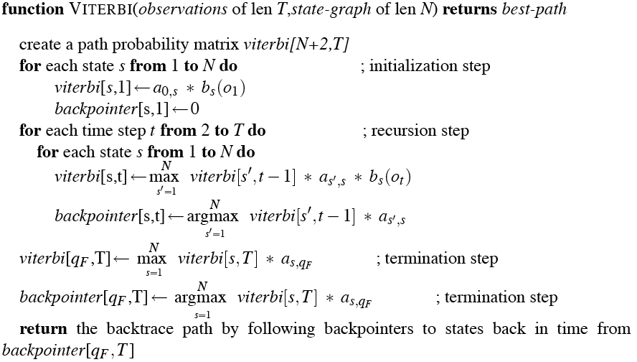
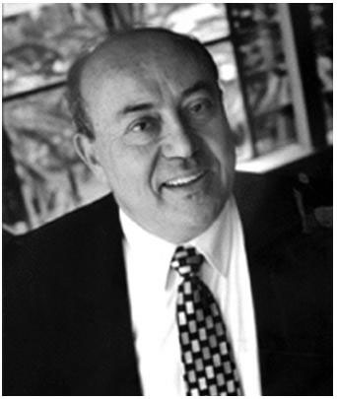
The Viterbi Algorithm

Slide 35
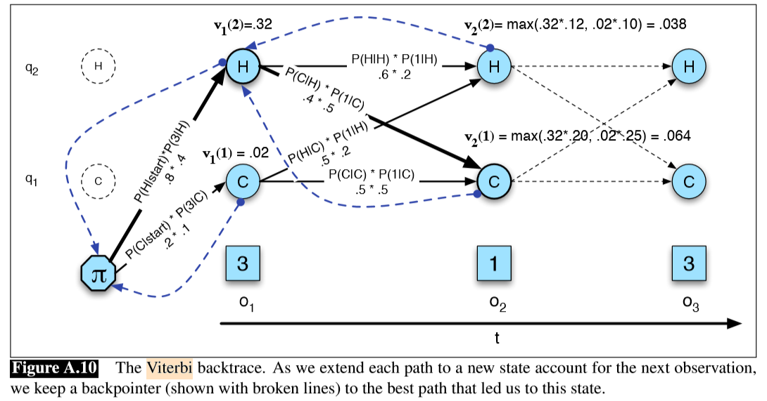
Viterbi Example: Ice Cream

Slide 36
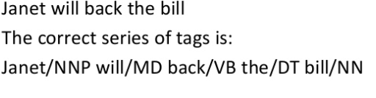
Example3

Slide 37
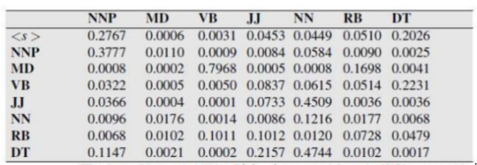
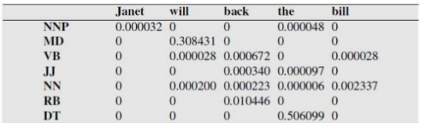

Slide 38
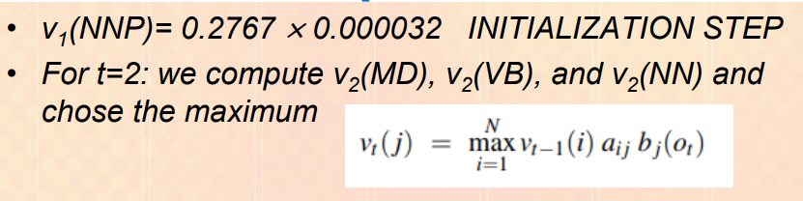
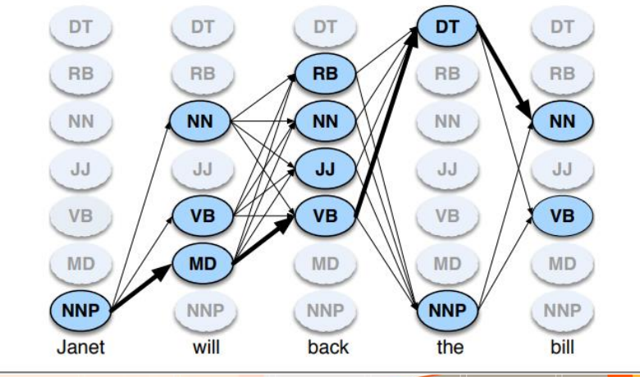

Slide 39
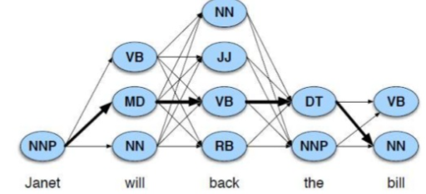


Slide 40
Practice question
Suppose you want to use a HMM tagger to tag the phrase ,”the light book “,Where we have the following probabilities
P(the|Det)=0.3,P(the|Noun)=0.1,P(light|noun)=0.003,P(light|Adj)=0.002,P(light|verb)=0.06,P(book|noun)=0.003,P(book|verb)=0.01
P(Verb|Det)=0.00001,P(Noun|Det)=0.5,P(Adj|Det)=0.3,
P(Noun|Noun)=0.2,P(Adj|Noun)=0.002,P(Noun|Adj)=0.2,
P(Noun|Verb)=0.3,P(Verb|Noun)=0.3,P(Verb|Adj)=0.001,P(verb|verb)=0.1
Assume that all the tags have the same probabilities at the beginning of the sentence . Using Viterbi algorithm find out the best tag sequence.

Slide 41
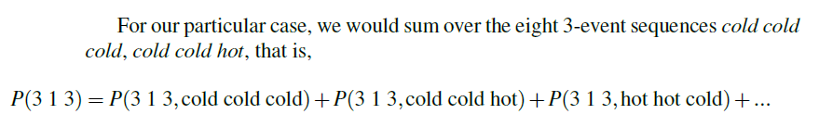
Forward
Efficiently computes the probability of an observed sequence given a model
P(sequence|model)
Nearly identical to Viterbi; replace the MAX with a SUM

Slide 42
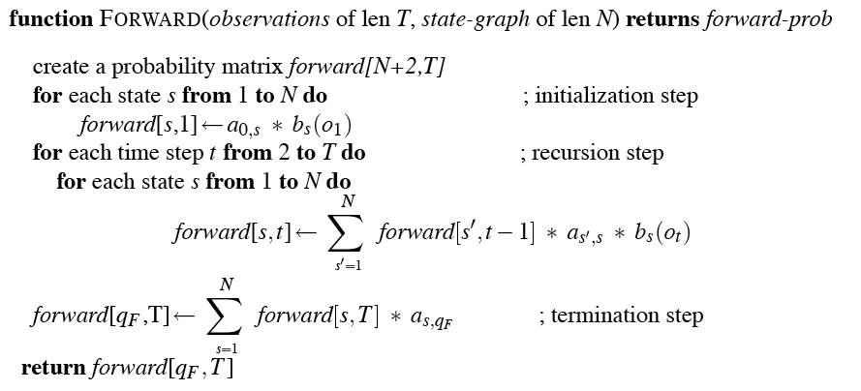
The Forward Algorithm

Slide 43
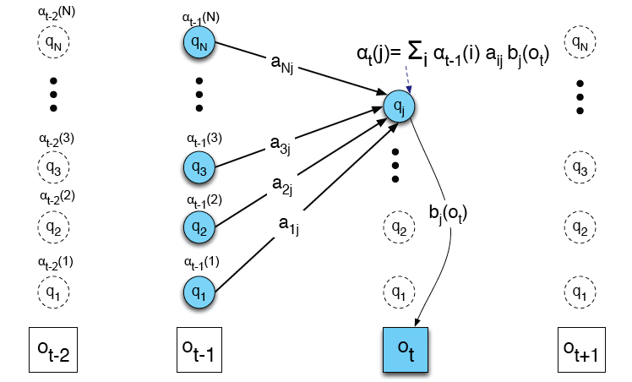
Visualizing Forward

Slide 44
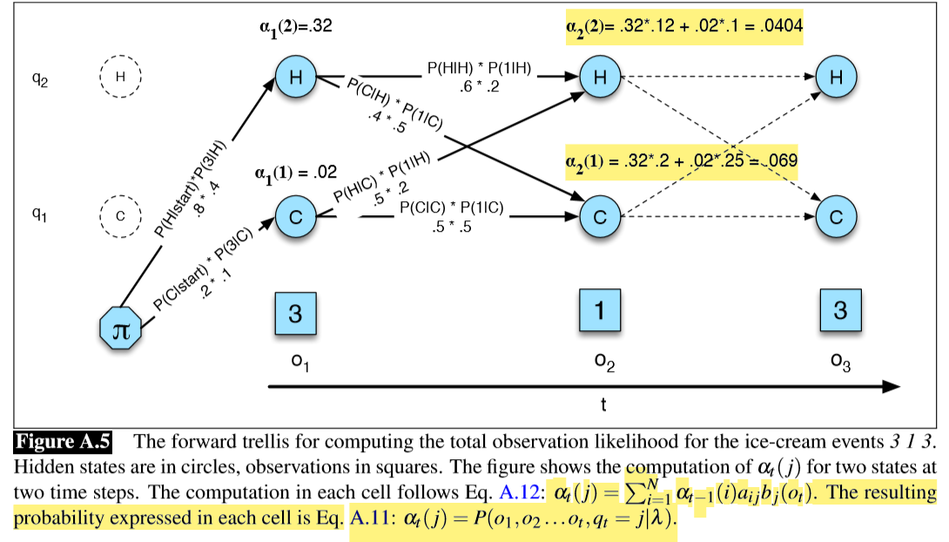
Forward Algorithm: Ice Cream

Slide 45
Problem 3
Infer the best model parameters, given a skeletal model and an observation sequence...
That is, fill in the A and B tables with the right numbers...
The numbers that make the observation sequence most likely
Useful for getting an HMM without having to hire annotators...
45

Slide 46
Forward-Backward
Baum-Welch = Forward-Backward Algorithm (Baum 1972)
Is a special case of the EM or Expectation-Maximization algorithm
The algorithm will let us learn the transition probabilities A= {a_{ij}} and the emission probabilities B={b_{i}(o_{t})} of the HMM
39
Notes:
46

Slide 47
Bidirectionality
One problem with the HMM models as presented is that they are exclusively run left-to-right.
Viterbi algorithm still allows present decisions to be inﬂuenced indirectly by future decisions,
It would help even more if a decision about word wi could directly use information about future tags ti+1 and ti+2.

Slide 48
Bidirectionality
Any sequence model can be turned into a bidirectional model by using multiple passes.
For example, the ﬁrst pass would use only part-of-speech features from already-disambiguated words on the left. In the second pass, tags for all words, including those on the right, can be used.
Alternately, the tagger can be run twice, once left-to-right and once right-to-left.
In Viterbi decoding, the classiﬁer chooses the higher scoring of the two sequences (left-to-right or right-to-left).
Modern taggers are generally run bidirectionally.

Slide 49
Some limitation of HMMS
Unknown words
First order HMM
Eg:
Is clearly marked
He clearly marked

Slide 50
Maximum Entropy Markov Model
Turn logistic regression into a discriminative sequence model simply by running it on successive words, using the class assigned to the prior word as a feature in the classiﬁcation of the next word.
When we apply logistic regression in this way, it’s called maximum entropy Markov model or MEMM

Slide 51
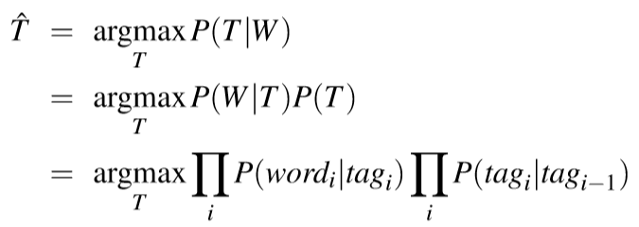
Maximum Entropy Markov Model
Let the sequence of words be W = w^{n} ₁ and the sequence of tags T = t^{n}₁.
In an HMM to compute the best tag sequence that maximizes P(T|W) we rely on Bayes’ rule and the likelihood P(W|T):

Slide 52
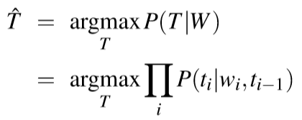
Maximum Entropy Markov Model
In an MEMM, by contrast, we compute the posterior P(T|W) directly, training it to discriminate among the possible tag sequences:

Slide 53
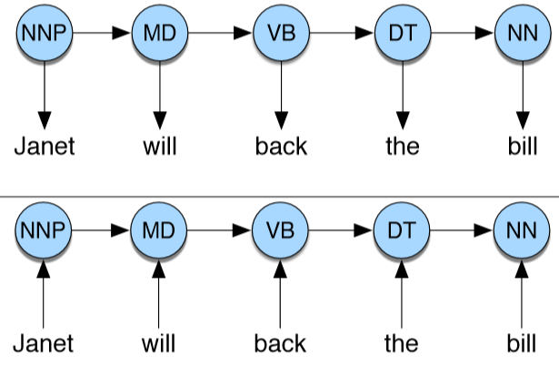
Maximum Entropy Markov Model
Consider tagging just one word. A multinomial logistic regression classiﬁer could compute the single probability P(ti|wi,ti−1) in a different way than an HMM
HMMs compute likelihood (observation word conditioned on tags) but MEMMs compute posterior (tags conditioned on observation words).

Slide 54
Learning MEMM
Learning in MEMMs relies on the same supervised learning algorithms we presented for logistic regression.
Given a sequence of observations, feature functions, and corresponding hidden states, we use gradient descent to train the weights to maximize the log-likelihood of the training corpus.

Slide 55
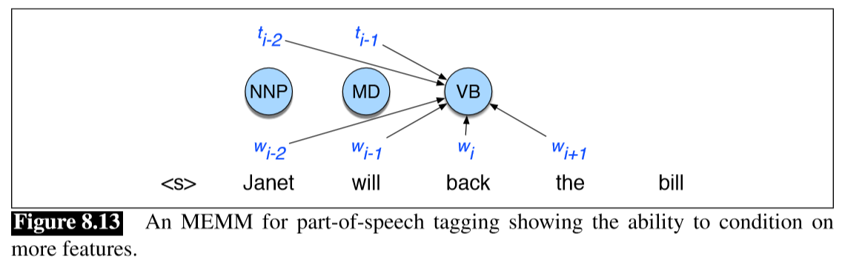
Maximum Entropy Markov Model
Reason to use a discriminative sequence model is that it’s easier to incorporate a lot of features

Slide 56
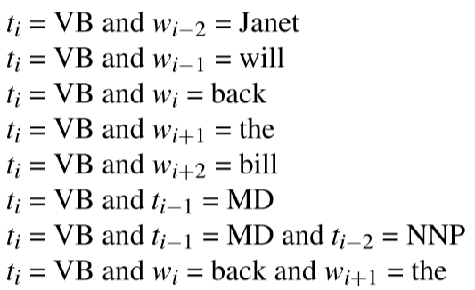
MEMM
Janet/NNP will/MD back/VB the/DT bill/NN, when wi is the word back, would generate the following features

Slide 57
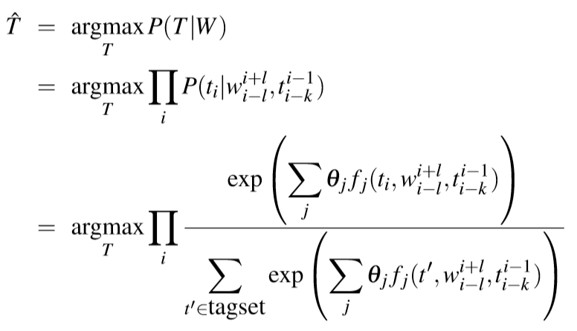
Training MEMMs
The most likely sequence of tags is then computed by combining these features of the input word w_{i}, its neighbors within l words w^{i+l} _{i−l}, and the previous k tags t^{i−1} _{i−k} as follows (using θ to refer to feature weights instead of w to avoid the confusion with w meaning words):

Slide 58
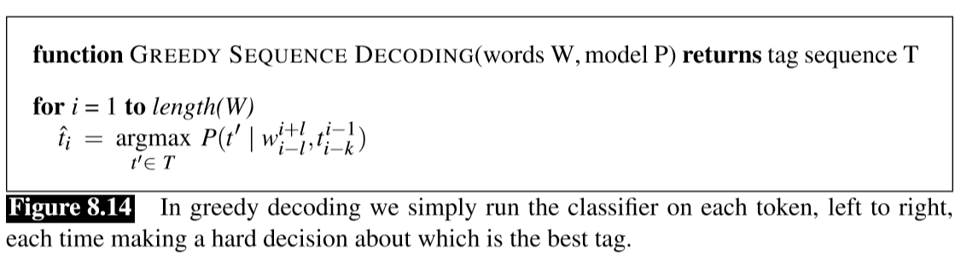
How to decode to ﬁnd this optimal tag sequence ˆ T?
Simplest way to turn logistic regression into a sequence model is to build a local classiﬁer that classiﬁes each word left to right, making a hard classiﬁcation on the ﬁrst word in the sentence, then a hard decision on the second word, and so on.
This is called a greedy decoding algorithm

Slide 59
Issue with greedy algorithm
The problem with the greedy algorithm is that by making a hard decision on each word before moving on to the next word, the classiﬁer can’t use evidence from future decisions.
Although the greedy algorithm is very fast, and occasionally has sufﬁcient accuracy to be useful, in general the hard decision causes too great a drop in performance, and we don’t use it.
MEMM with the Viterbi algorithm just as with the HMM, Viterbi ﬁnding the sequence of part-of-speech tags that is optimal for the whole sentence

Slide 60



MEMM with Viterbi algorithm
Finding the sequence of part-of-speech tags that is optimal for the whole sentence. Viterbi value of time t for state j
In HMM
In MEMM

Slide 61
HMM Applications
Speech Recognition including siri
Gene Prediction
Handwriting recognition
Transportation forecasting
Computational finance
And all applications which requires sequence processing…

Slide 62
References
https://www.nltk.org/
https://likegeeks.com/nlp-tutorial-using-python-nltk/
https://www.guru99.com/pos-tagging-chunking-nltk.html
https://medium.com/greyatom/learning-pos-tagging-chunking-in-nlp-85f7f811a8cb
https://nlp.stanford.edu/software/tagger.shtml
https://www.forbes.com/sites/mariyayao/2020/01/22/what-are--important-ai--machine-learning-trends-for-2020/#601ce9623239
https://medium.com/fintechexplained/nlp-text-processing-in-data-science-projects-f083009d78fc

